Slide 1
iRCC 2016 Climb Up Luxov Boulder Radovljica
No changes – no development
06.03.2016 Radovljica

Slide 2
What is going to change?
For the first time the competition will be organised in one hall.
The complete competition will be visible from the tribune.
Revolution – sensors and computer will take care of the results – this will be the first test – just Airbag Boulder duel.
Two high walls will be dissasemled to set 4 boulder walls and then assembled back after the first part of the event.
As the grand finale we will present Airbag Boulder Duel competition.
Better media coverage including live streaming on the web.
The schedule of the competition is new.
New warm up zone with warm up wall.

Slide 3
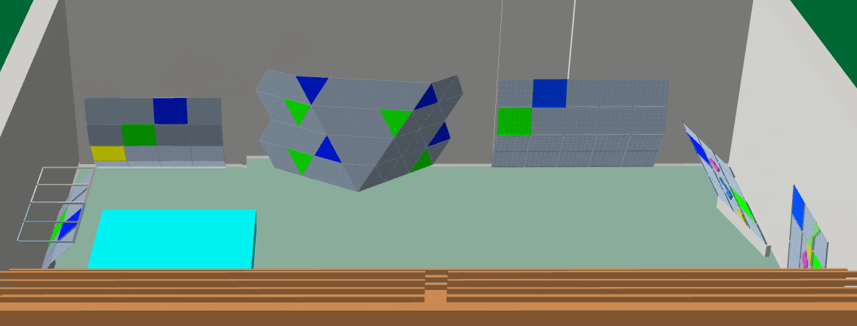
Competition venue
The gym is actually big but this time it will be filled with boulders.

Slide 4
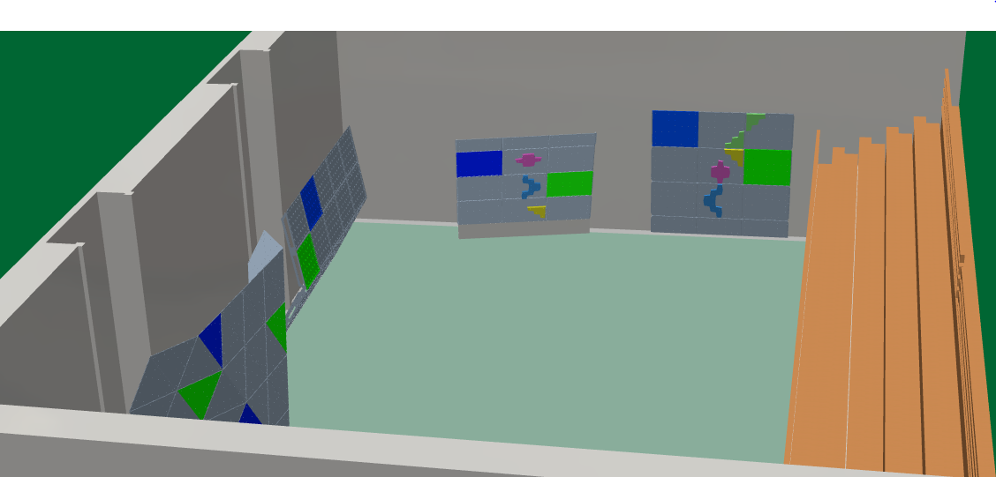
Attending the event
According to the boulder walls arrangement is probably clear that in the gym will be no place for the seats. All visitors are kindly asked to use the tribune.

Slide 5
Revolution !?
For the first time a new system will be used which will recognize which holds were touched or controled by the climber. System will simultaneusly decide when the bonus or top hold was scored. Touched holds will glow yellow, scored holds will glow green and computer will publish the results immediately.
System will be presented just on the final Airbag Boulder Duel . It’s development project managed by French holds producer Volx (system name is Luxov) and Slovenian wall producer Climb Up.
We hope that the system will perform reasonably well in first tryal. On the other side we are aware that much more test events will have to be organised with the goal to make the system perfect. We ‘re proud to be able to start this process and to hear the comments by the most attentive public.

Slide 6
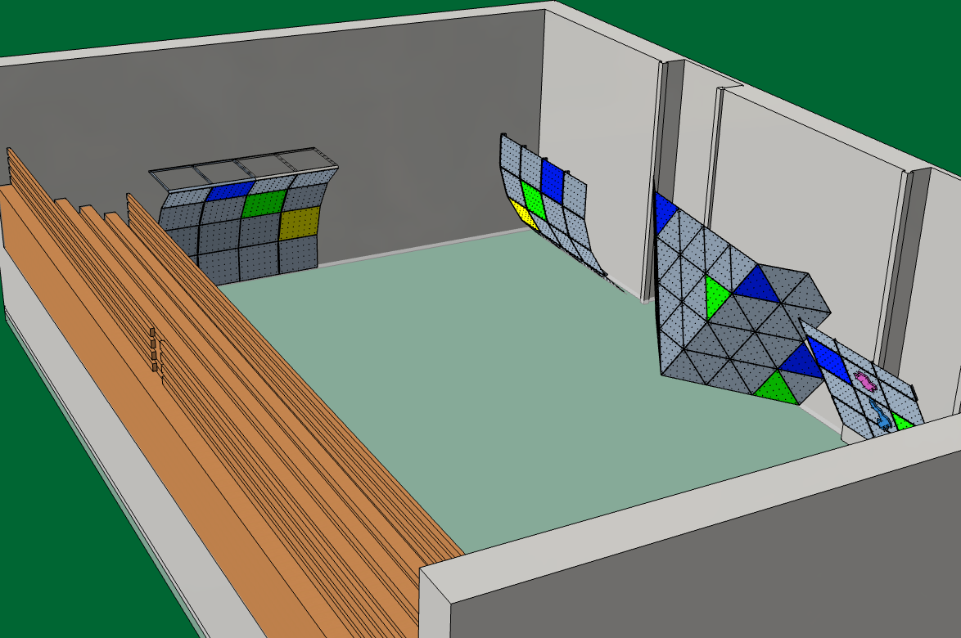
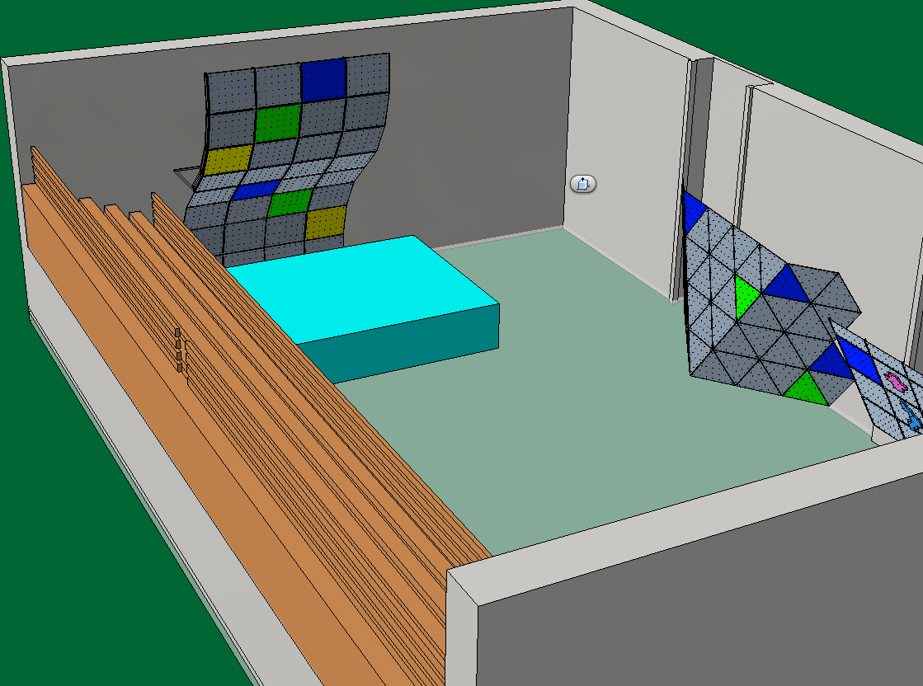
Adaptive walls
Normally climbing walls don’t fly, however in Radovljica we will see few exceptions. Two high walls will be dissasembled in four boulder walls and after the first part of the event they will be assembled back in high walls.

Slide 7
Grand finale venue

Slide 8
Is sport climbing adrenalin sport?
This dilema won’t be present in grand finale.
The rope will with some luck not be present.
8 m long, 6 m wide and 1,5 m thick Airbag will do the job with relative low accelerations.
Competition will run in pairs with eliminations.
Routes will be 8a – 8b (Lead ranking).
Routes will be equiped with 3 bonuses and one top with the help of Luxov.
The duel winner will be the climber with beter result by the Boulder rules. In case of tie the shorter time decides the winner.
Few best climbers in the world will take part. The best competitors from iRCC will have the chance to join them.

Slide 9
Competition schedule
At 09:30 group U10 and U8 will start to climb. Climbing time - 1h 15 min – 10:45.
At 11:15 group U12 will start to climb. Climbing time - 1h 30 min – 12:45.
At 13:15 group U14 will start to climb. Climbing time - 1h 30 min – 14:45.
At 15:15 group U16 and H16 female will start to climb. Climbing time - 1h 30 min – 16:45.
At 17:15 U16 and H16 male will start to climb. Climbing time - 1h 30 min – 18:45.
At 19:00 the grand finale will start – duels of the best climbers – Airbag boulder duel

Slide 10
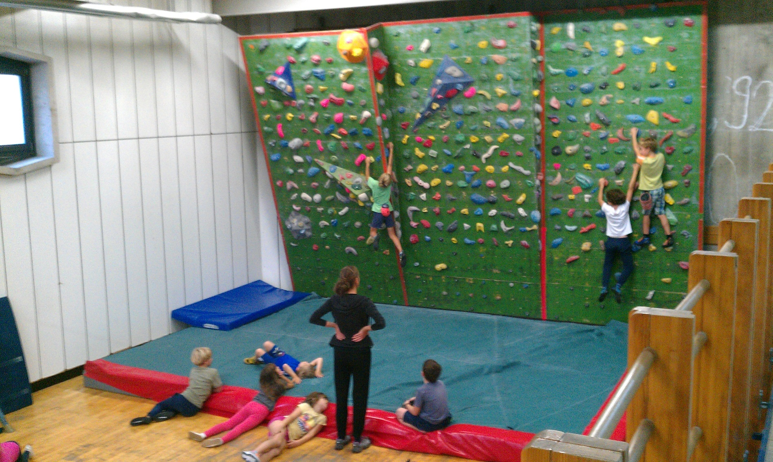
Warm up
Small gym will be completely reserved just for warm up.

Slide 11
Why so many changes?
So many changes at once mean a great risk, a lot of work and also significant financial effort ☹.
We want to ensure that each competitor, each spectator and each trainer will in future exactly understand the result for each ascent ☺.
We want to develope a system which will support the just in time presentation of results on the wall (changing colors of the holds), in tables and other graphical presentations. This should mean the end of the guesswork and waiting for official results .
We want to maximize the pleasure of competitors and spectators with good knowledge of sport climbing. Parents are critical and therefore the best public to discower the mistakes of the system .

Slide 12
We will enjoy your visit
Each visitor is important because this way we can here more opinions .
Opinions from competitors, spectators , trainers, ... are important for future development of Luxov system and our competition.
Critical opinions are not an insult – we will take them as advices.
Sport climbers and climbing as sport deserve much more attention and respect no matter wheather it becommes Olympic sport.

